Slide 1
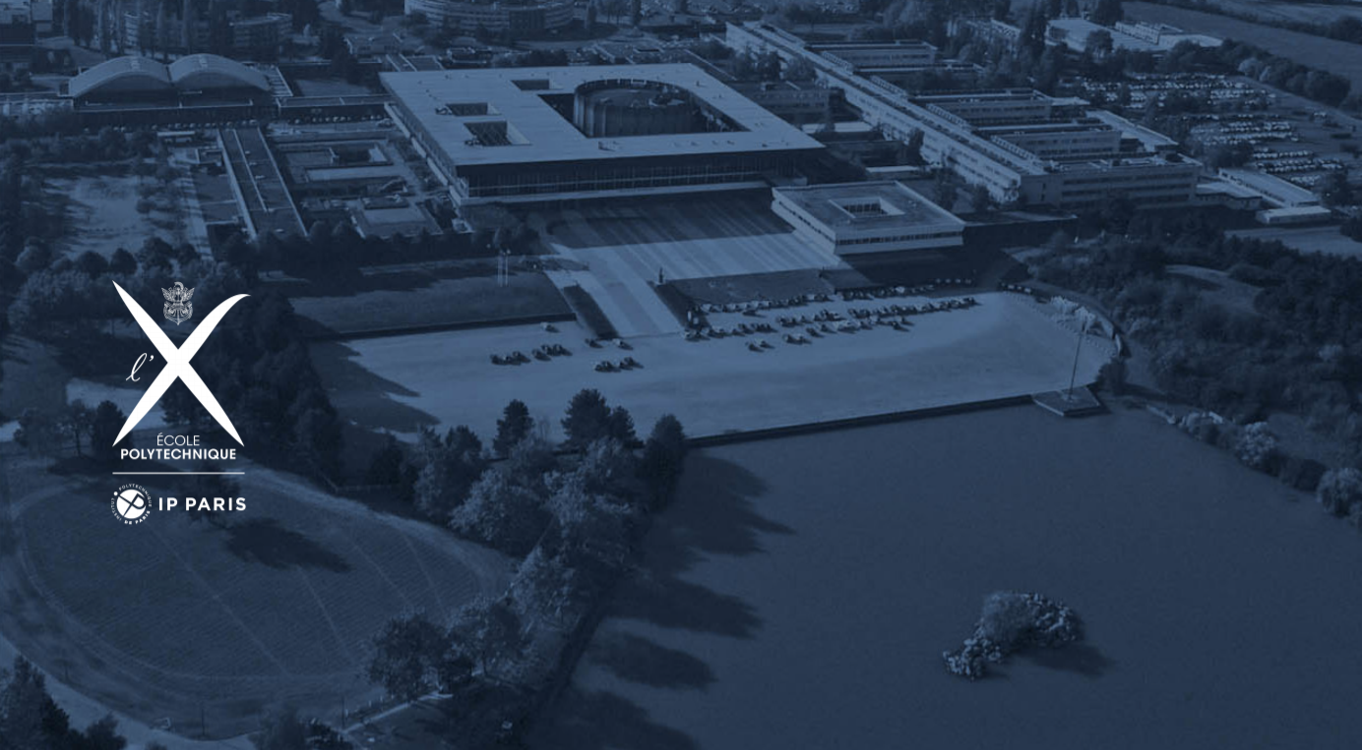
INF560
Towards Paralleled N-Body Interaction
Zhengqing Liu, Jiongyan Zhang
16/03/2022

Slide 2
Outline
Proposed solutions:
Background
Brute Force
Barnes Hut
Summary
Reference

Slide 3
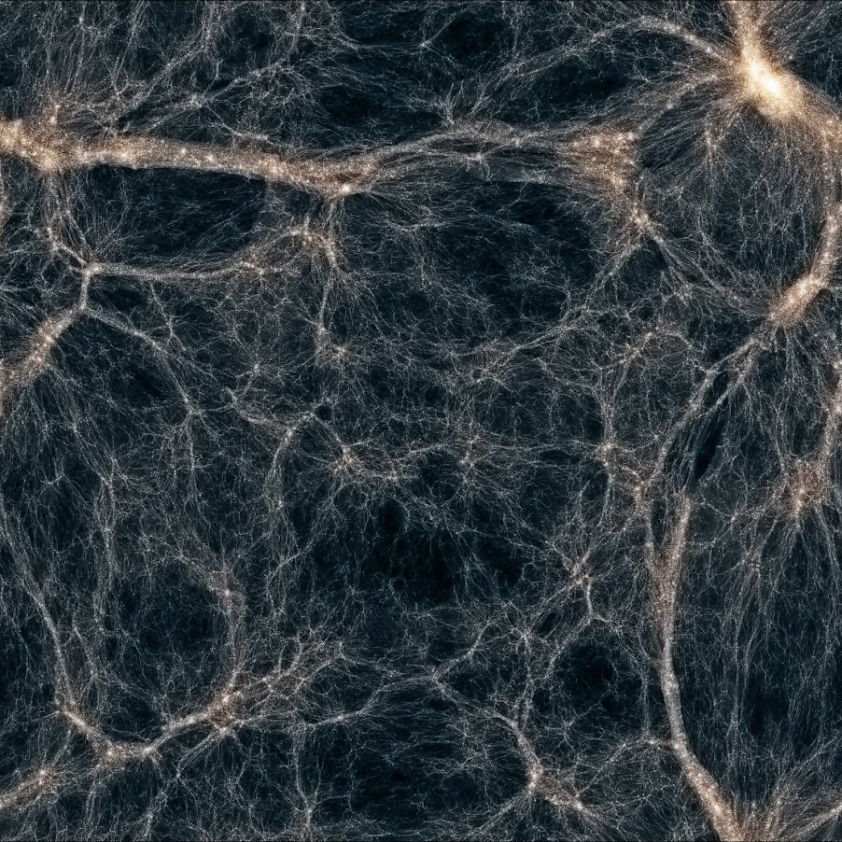
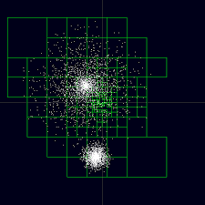
Proposed solutions:
Content
Background
N-Body Simulation
University of Washington. N-body shop, Department of Astronomy.

Slide 4
2. Brute Force
Proposed solutions:

Slide 5
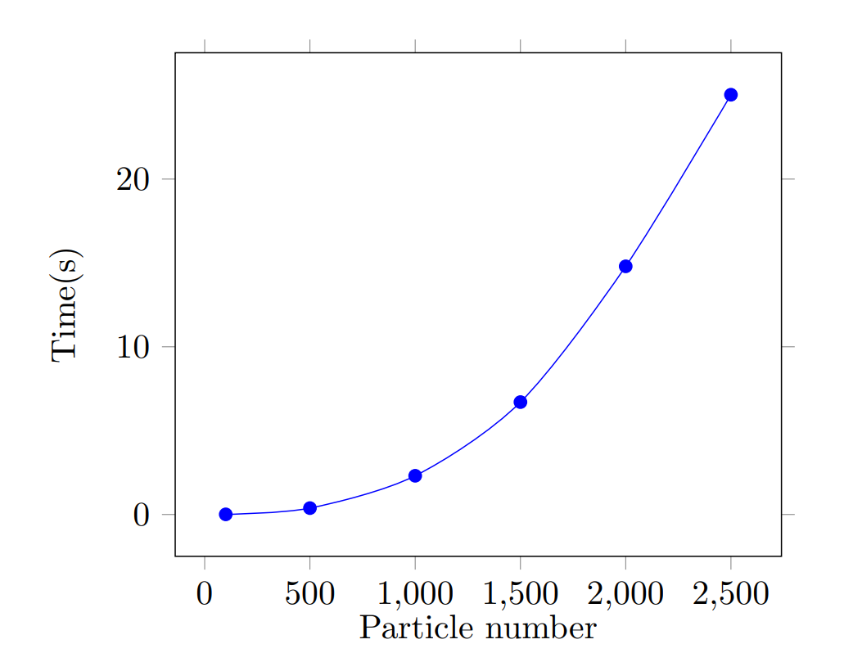
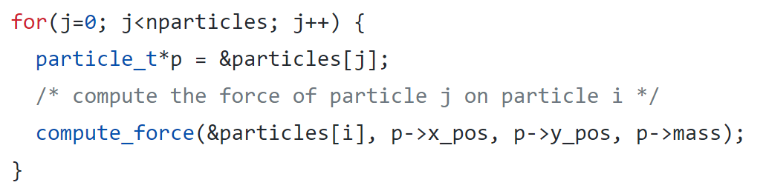
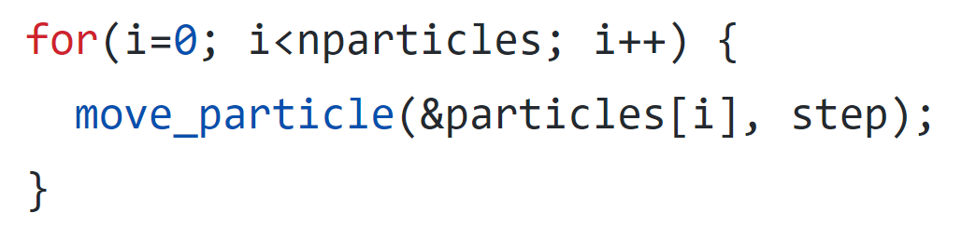
Proposed solutions:
Content
2.1 Sequential Brute Force
Two essential tasks (for-loops)
Force computation
Position movement
౦(n²)

Slide 6
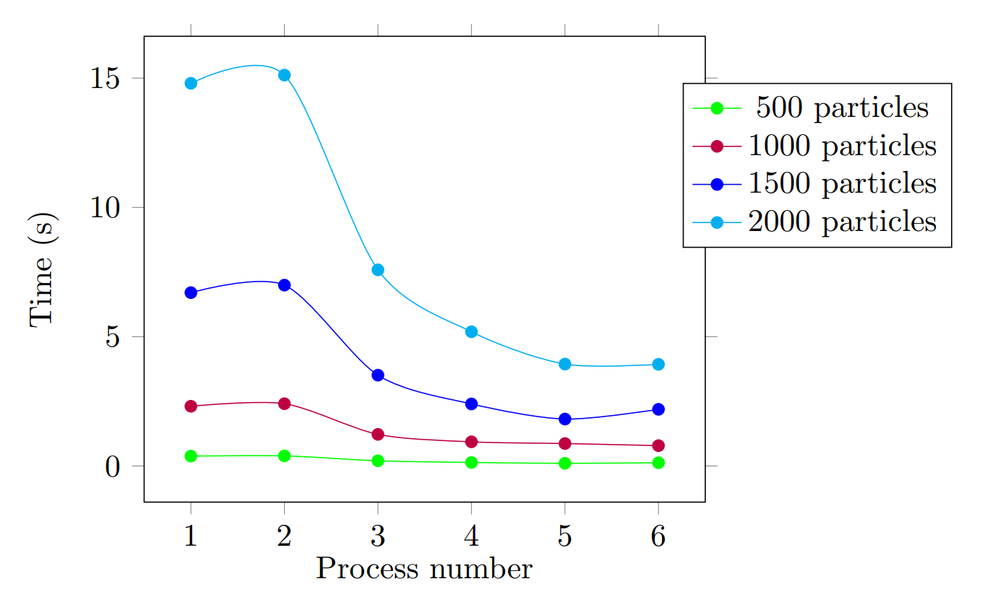
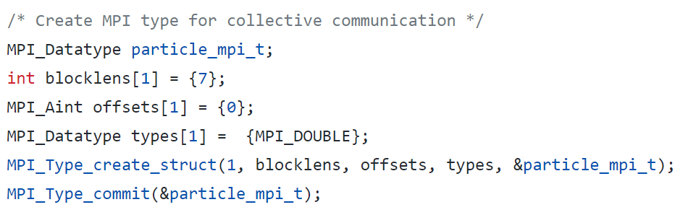
Proposed solutions:
Content
4 processes, 10 particles
each slave: 10/3 = 3
master = 10 % 3 =1
2.2 MPI Brute Force
Master and Slave process
master - distribute tasks, move position, sync, do the modulus force computation
slave - force computation (equally)
Collective communication (Bcast, gatherv) - new MPI datatype
Sync max_acc, max_speed using MPI_Send

Slide 7
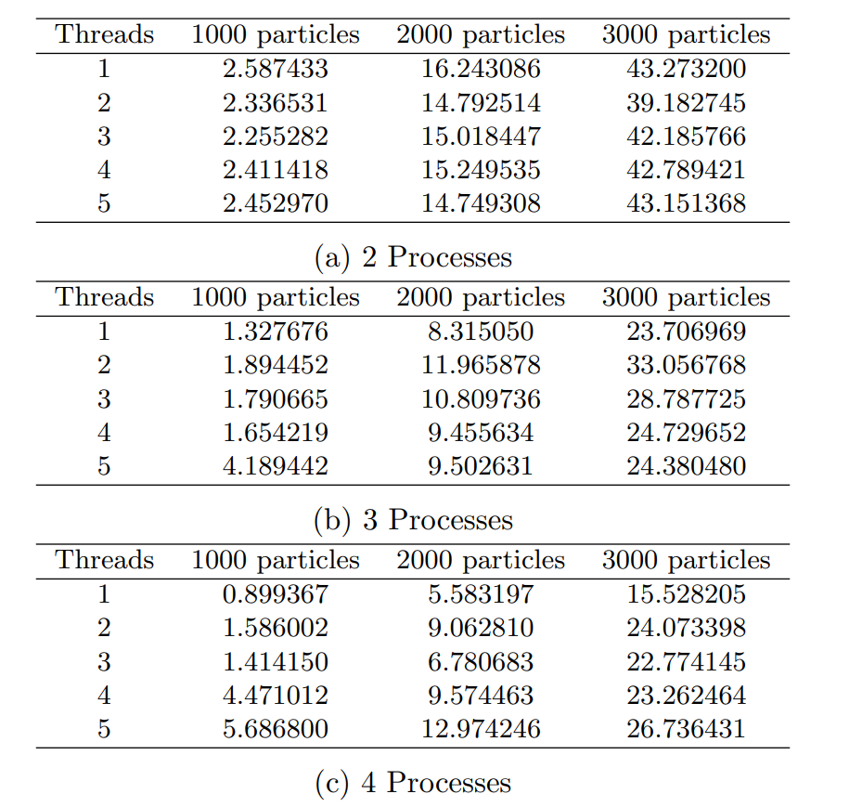
Proposed solutions:
Content
2.3 MPI + OpenMP Brute Force
Fine-grain hybrid programming
Distribute tasks among MPI ranks
Omp parallel for region for each subpart
Loop scheduling
Outcome
Trivial and unstable (even worse) effects than pure MPI
Obvious slow-down with many threads and processes
Amdahl’s law + launching and maintaining costs on thr/proc

Slide 8
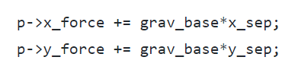
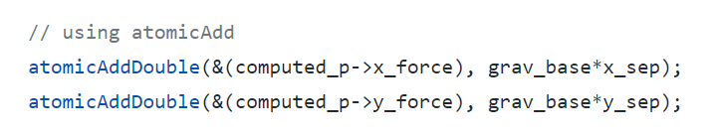
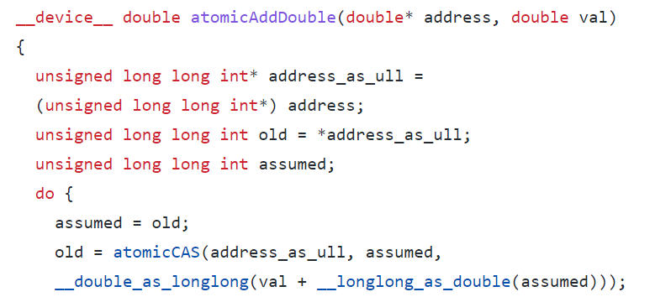
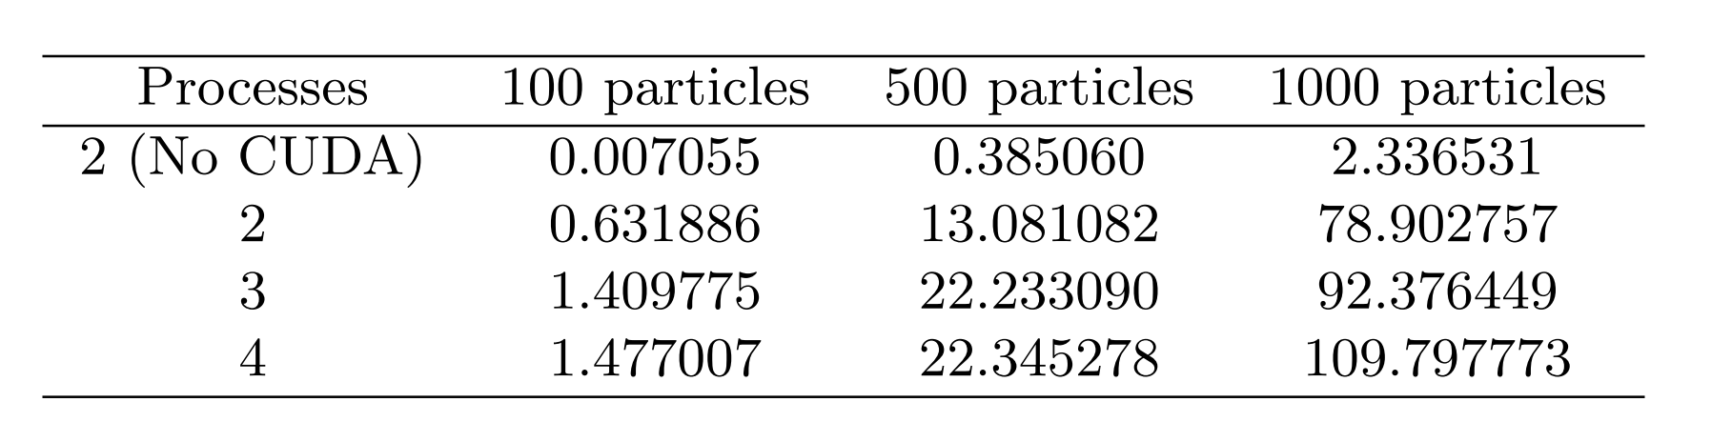
Proposed solutions:
Content
2.3 MPI + OpenMP + CUDA Brute Force
extern "C" void cuda_compute_force(int i, int nparticles, particle_t * p)
__global__ void __compute_force__ (int * i, int * nparticles, particle_t * d_p)

Slide 9
3. Barnes Hut
Proposed solutions:

Slide 10
Proposed solutions:
Content
3.1 Parallelism strategy
The main idea is to create a for-loop for computing the force.
Fail
1. Flatten the quad-tree: Linear quad-tree
Not good
2. Recursion to non-recursion: Iteration method
3. Tricky coding: Derive the address of particles
Succeed
Notes:
As to parallelize Barnes Hut, we have three strategies. The first is linear quad-tree. The linear structure is convenient for process and device transfer, and extremely easy for parallelism. However we failed because the linear structure requires too much redundant space, which may exceed the heap size especially in the CUDA environment. The non-recursion edition mainly serves the CUDA environment, as CUDA is not friendly to recursion operations - but the final outcome duration does not have too much improvement. Finnaly we noticed that the particles array store the address of each particle, which makes the for-loop possible thus leading to convenient parallelism.

Slide 11
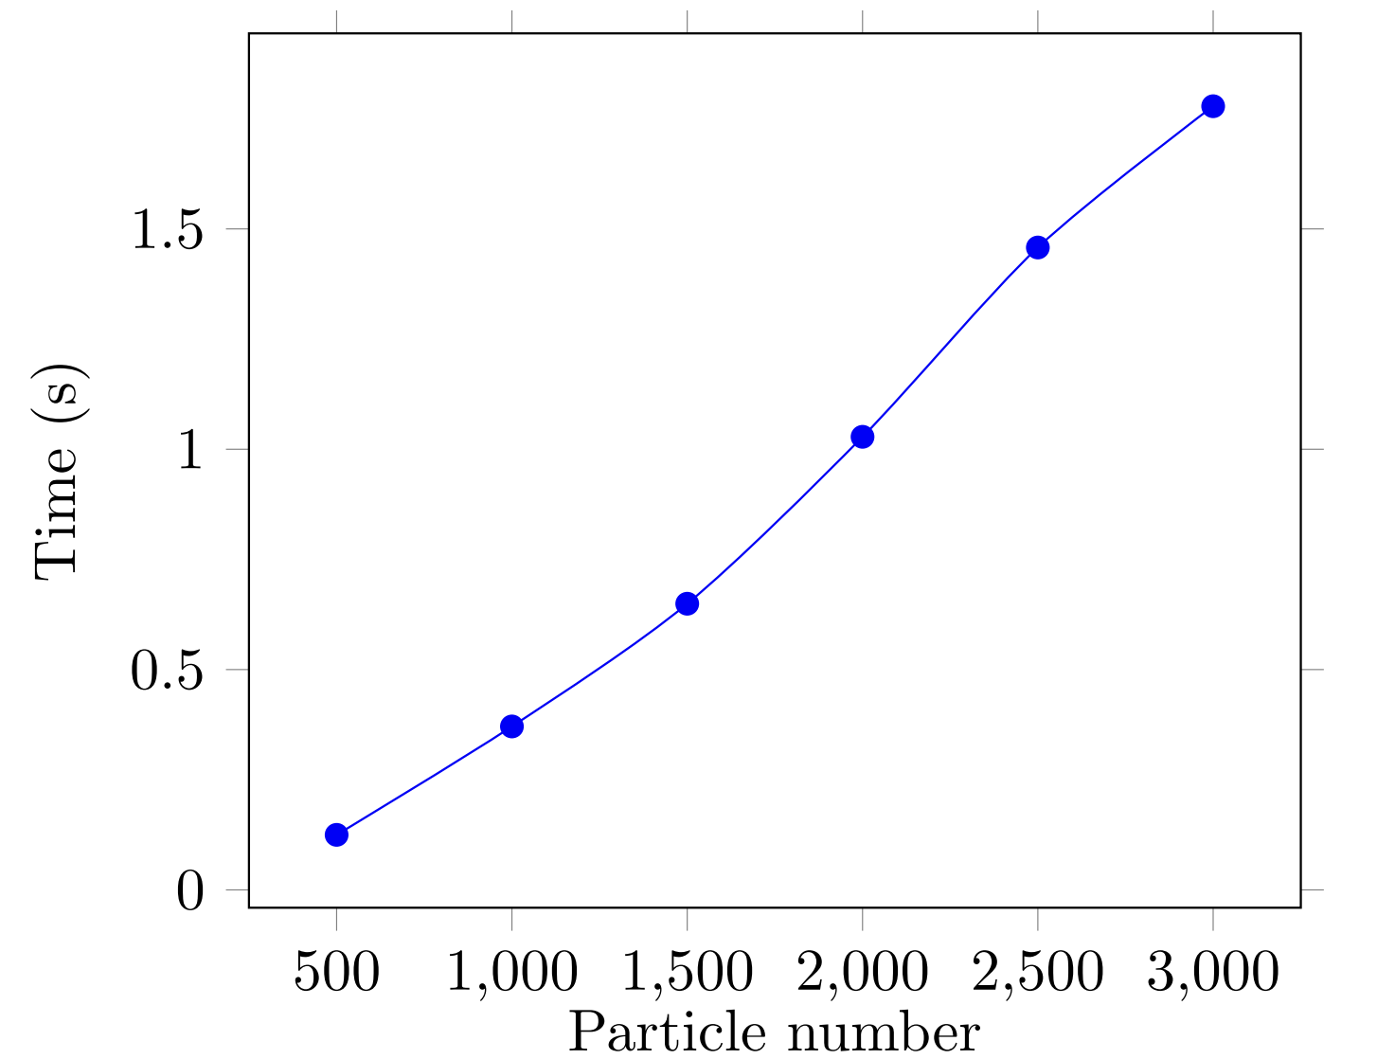
Proposed solutions:
Content
3.2 Non-parallelism performance
Barnes Hut Algorithm
Better efficiency in computing the n-body problem. It does not require go through all the particles again and again.
Notes:
This is the non-parallelism version. the execution time increases along with the particle number, mainly displays an approximate linear model. And we can find it costs less time than Brute Force.

Slide 12
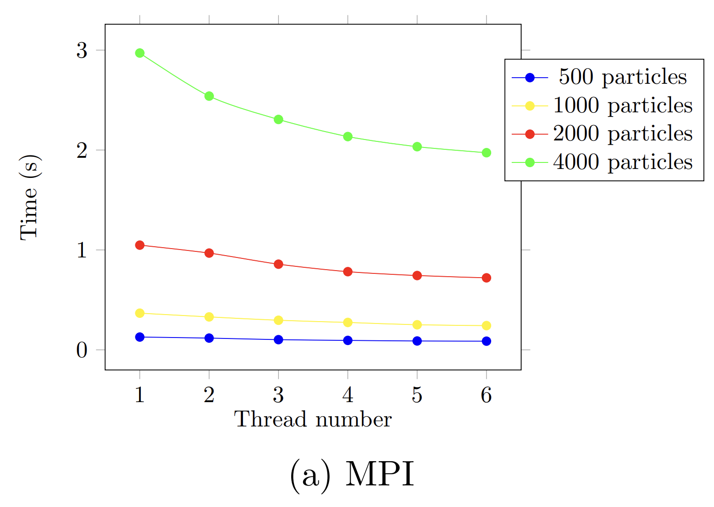
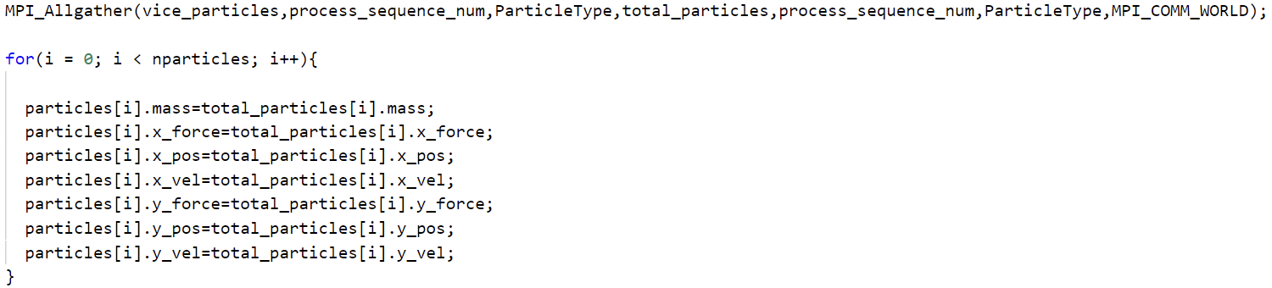
Proposed solutions:
Content
3.3 MPI Barnes Hut
Gradually assign cores to the program
- Slightly accelerate the program, and with more cores assigned, speed rises as well.
- Too many cores may lead to the performance decreasing.
Notes:
To avoid the transfer of complex quad-tree structure, our idea is to build the quad-tree in each process simultaneously, and then assign tasks to each process. Which should be noticed is to synchronize each step to keep each process have the same results. It may cost much time for communication. Thus more assigned cores may not have the best effect.

Slide 13
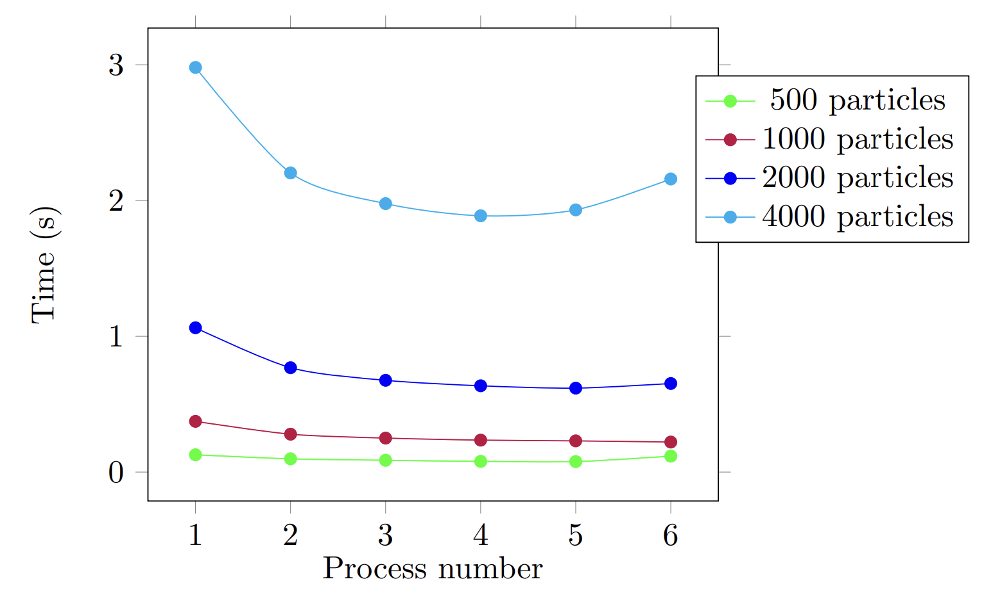
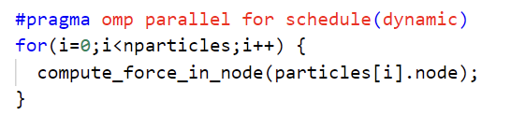
Proposed solutions:
Content
3.4 OpenMP Barnes Hut
Gradually assign threads to the program
- Shared memory system requires less communication cost compared with MPI.
- However, the speedup decreases as well.
- Context switch, memory synchronization, etc., take the main influence.
Notes:
OpenMP has a shared memory system, thus there is no need to have explicit operation to communicate between each thread. We can assign a certain part of whole particles to let them compute the force. The main pressure comes from context switch and memory synchronicity, which may decrease the speedup.

Slide 14
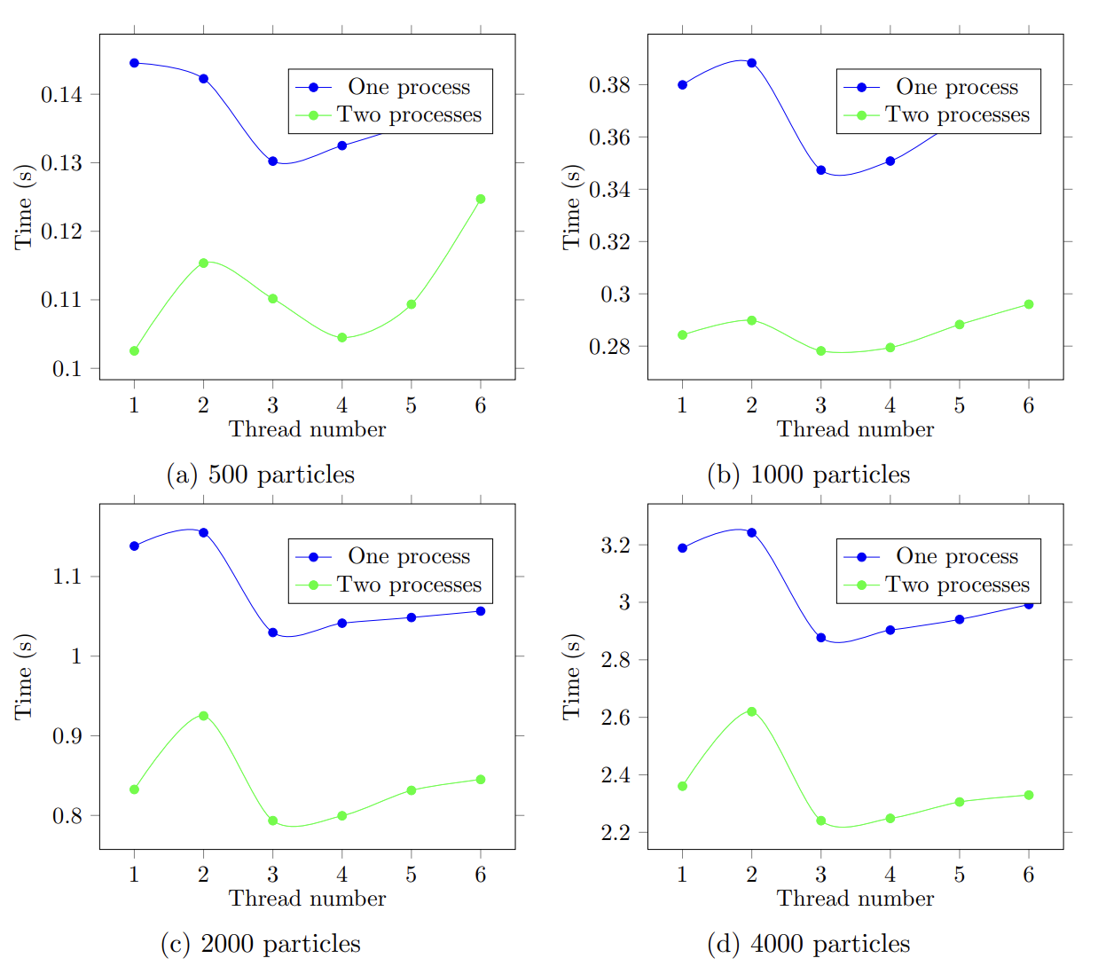
Proposed solutions:
Content
3.5 Hybrid Barnes Hut (1)
Hybrid structure is to use the nested approach, making each process capable of using multiple threads to carry out computing tasks.
6 THREADS, 3 PROCESSES, 4 AMOUNTS:
- Different input parameters to test the hybrid structure
- The result shows that the MPI does help to decrease the execution time, while 2 threads lead to a time peak.
Notes:
In the hybrid mode, we make MPI contain OpenMP: each process gets a certain number of tasks and then being shared by each sub-threads. However, the acceleration from OpenMP is not large. Meanwhile, we can notice there are peaks when we use 2 threads. We believe that the main problem comes from the thread cost that covers effect from acceleration.

Slide 15
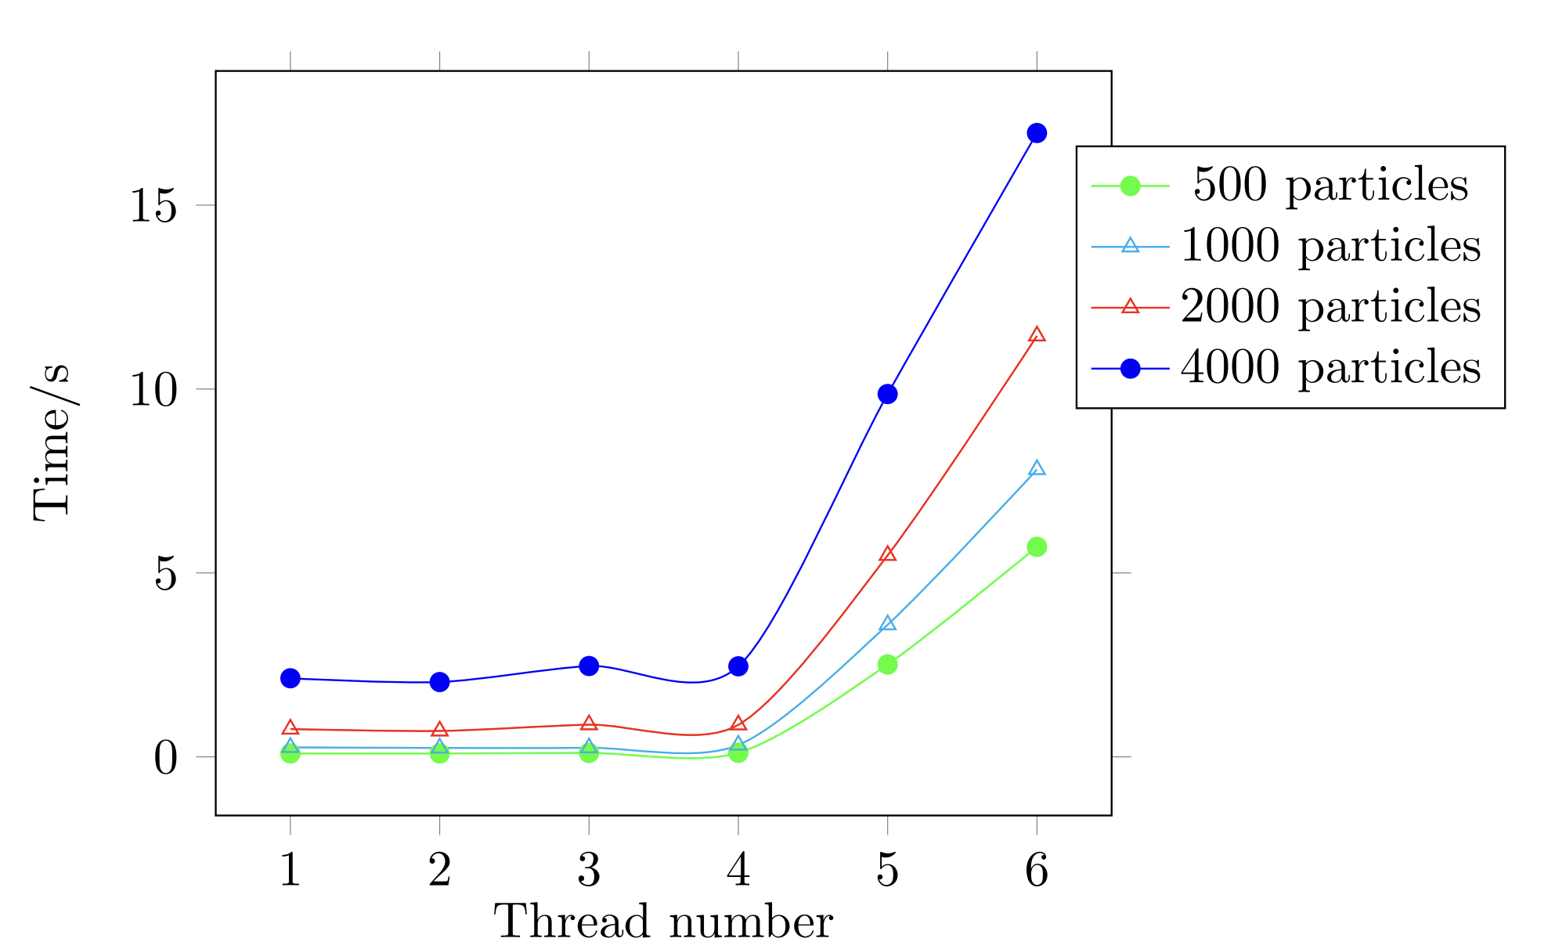
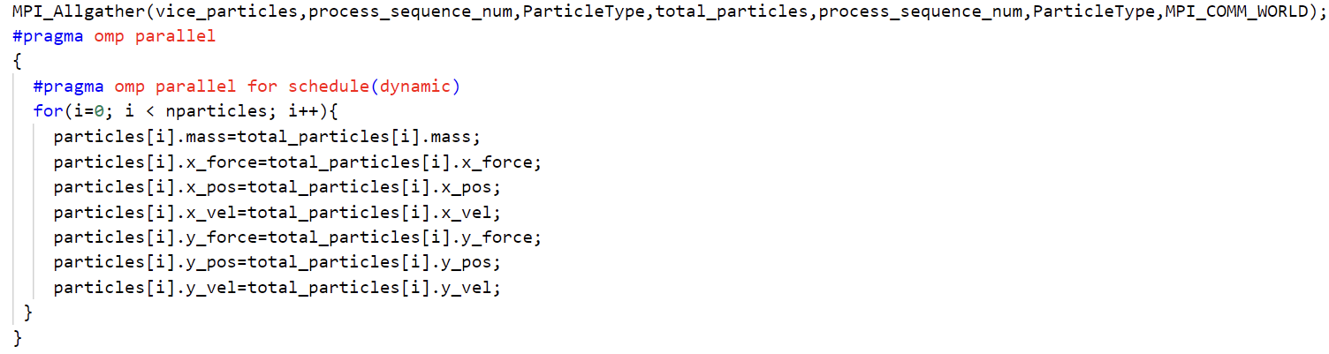
Proposed solutions:
Content
3.5 Hybrid Barnes Hut (2)
Abnormality while utilising >=3 processes
performance degrades sharply (mainly with >=5 threads) in any particle number level.
Notes:
The abnormal situation is worthy concentrating as well. We can notice that when use 3 processes, the program performance worsens after 5 and 6 threads applied. We believe that the context switch is the main problem as the product of the thread number and process number may exceed the system affordance.

Slide 16
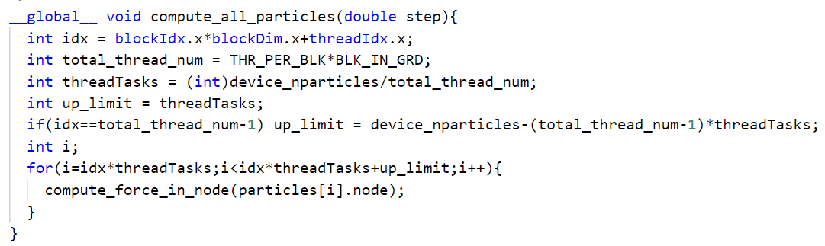
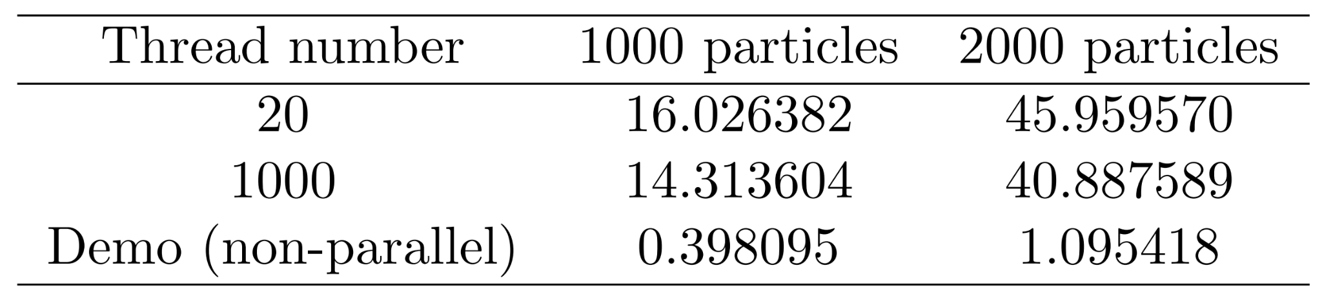
Proposed solutions:
Content
3.6 CUDA Barnes Hut
The idea is to establish a quad-tree in GPU.
The CUDA model has a very bad effect on the algorithm.
The GPU is not suitable for the operations on a complicated structure, which is limited by the device performance;
The Barnes Hut algorithm is not a computing intensively program.
Notes:
Our coding logic in CUDA is try to establish the quad-tree in GPU, as it is quite hard to move a large quad-tree from CPU to GPU. However, the memory limitation in GPU may cause a great hinder, so expanding stack or heap size is necessary. Even doing this, the result is not ideal. CUDA leads to great performance decrease compared with computing on CPU. We can have two guess:

Slide 17
Content
Summary
In this work, we target at paralleling N-body simulation (Brute Force and Barnes Hut) with MPI, OpenMP and CUDA.
Brute Force
MPI largely speeds up the computation
OpenMP provides slight enhancement in a fine-grain mode
CUDA slows down the task at several magnitude of orders
Barnes Hut
Handle the complex tree structure via memory share or structure synchronization
MPI: using space to avoid transfer, leading to acceleration
OpenMP: shared memory to avoid transfer to speed up
Hybrid: be careful of the device limitation
CUDA: not suitable for the complex structure and the non-computing-intensive algorithm
What we learned/acquired?
Multiple parallelism paradigms
Various factors which influence the parallelism efficiency
Proper collaboration with tutors and mates
Which skills should we keep reinforcing in the future?
Habits/styles of Coding
Analyze deeper influence on parallelism
Notes:
In this project, we try to use various parallelism tools to parallelize the n-body algorithm. In Brute Force, we learn that OpenMP and MPI have different parallelism effect on the algorithm, and CUDA may lead to a worse outcome. In Barnes Hut, the most fundamental issue is how to handle the tree structure. To solve this, we apply some coding trick and use strategies we have mentioned, and finally get the acceleration in a certain degree. However, CUDA is also not suitable for such a structure.
Meanwhile, we have learnt a lot from this course, which greatly improves our ability and understanding in the parallelism domain.

Slide 18
Content
Reference
[1] Sverre J Aarseth and Sverre Johannes Aarseth. Gravitational N-body simulations: tools and algorithms. Cambridge University Press, 2003.
[2] Maida Arnautovi ́c et al. “Parallelization of the ant colony optimization for the shortest path problem using OpenMP and CUDA”. In: 2013 36th International Convention on Information and Communication Technology, Electronics and Mi-croelectronics (MIPRO). IEEE. 2013, pp. 1273–1277.
[3] Marco Bertini. GPU Programming Basics. 2017. url: https://www.micc.unifi.it/bertini/download/gpu-programming-basics/2017/gpu _cuda_5.pdf.
[4] John Smith and S-F Chang. “Quad-tree segmentation for texture-based image query”. In: Proceedings of the second ACM international conference on Multimedia. 1994, pp. 279–286.
[5] Michele Trenti and Piet Hut. “N-body simulations (gravitational)”. In: Scholarpedia 3.5 (2008), p. 3930.
[6] Laurens Van Der Maaten. “Barnes-hut-sne”. In: arXiv preprint arXiv:1301.3342 Add to Citavi project by ArXiv ID (2013).
[7] Wikipedia. N-body Simulation. [Online; accessed 13-March-2022]. 2022. url: https://en.wikipedia.org/wiki/N-body_simulation.

Slide 19
THANKS
Zhengqing Liu, Jiongyan Zhang
16/03/2022

